Slide 1

U.S. ALTERNATIVE ENERGY VEHICLE ADOPTION
An analysis on the most ideal locations to own and drive alternative energy vehicles.
GROUP MEMBERS:
VINITA SINGH
JOE LOMAS
RAGHEN MORROW

Slide 2
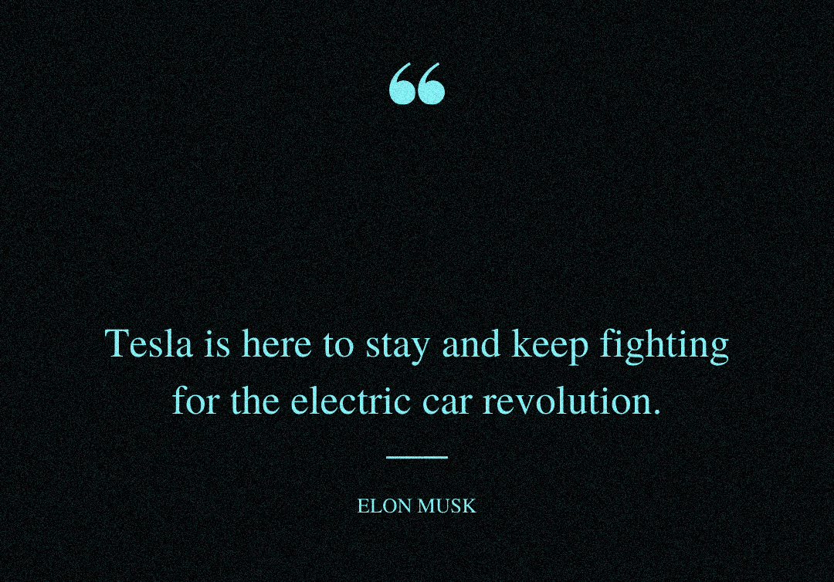
…He wants revolution, but the consumers want revelation! Let’s check it out!...

Slide 3
PROJECT OVERVIEW

Slide 4

AMERICA'S THOUGHTS ON ELECTRIC VEHICLES
Most Americans aren't yet sold on going electric for their next cars!
About 4 in 10 US adults are at least “somewhat likely” to switch
8% of U.S. adults say they or someone in their household owns or leases an electric vehicle
8% say their household has a plug-in hybrid vehicle
According to a poll conducted by The Associated Press-NORC Center for Public Affairs Research and the Energy Policy Institute at the University of Chicago (2023)

Slide 5
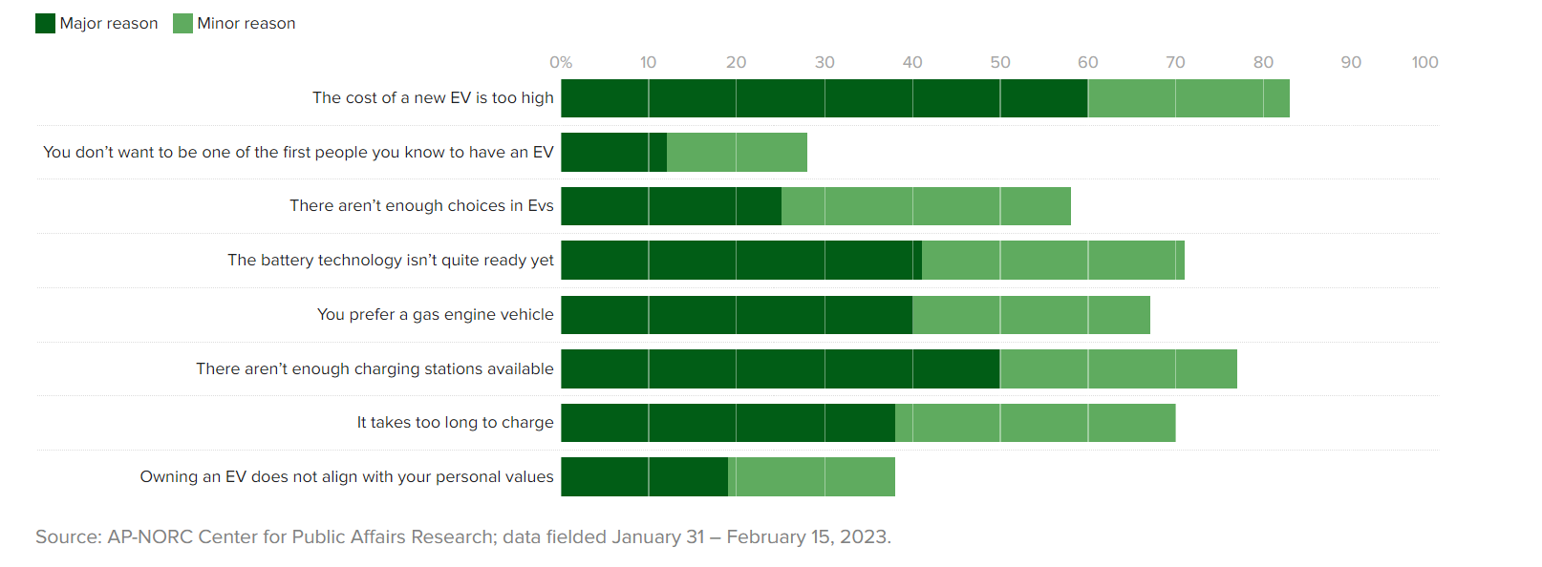
AMERICANS VOTED… HERE IS THEIR REASONING!
The prices are too high and there are too few charging stations!

Slide 6
WHICH STATES ARE THE MOST SUPPORTIVE OF ALTERNATIVE ENERGY VEHICLES? (BIODIESEL, ELECTRIC, ETHANOL (E85), RENEWABLE DIESEL)
PRESENTED BY: VINITA

Slide 7
DIFFERENT FUEL TYPES:
BIODIESEL - Renewable, biodegradable fuel manufactured from vegetable oils or animal fats. BD20 is the most common blend.
ELECTRIC - Battery packs provide electricity to power the vehicle.
ETHANOL (E85) or FLEX FUEL - High-level ethanol-gasoline blends containing 51% to 83% ethanol. Ethanol can be made from corn (USA) or sugarcane (Brazil).
RENEWABLE DIESEL - Diesel fuel produced from a renewable feedstock, predominantly a hydrocarbon

Slide 8
Alternate Fuel Stations across USA
BioDiesel 1110
Electric 9100
Ethanol (E85) 3200
RD 43
2.4 million electric vehicles registered in the United States.
Bloomberg projects EV sales of 1.9 million units in 2024

Slide 9
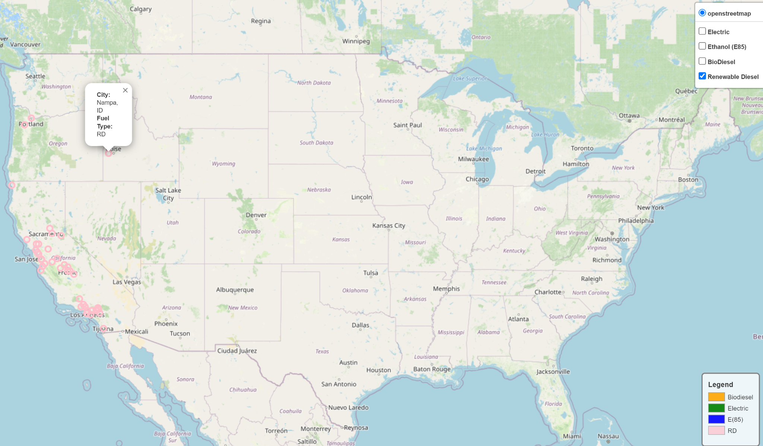
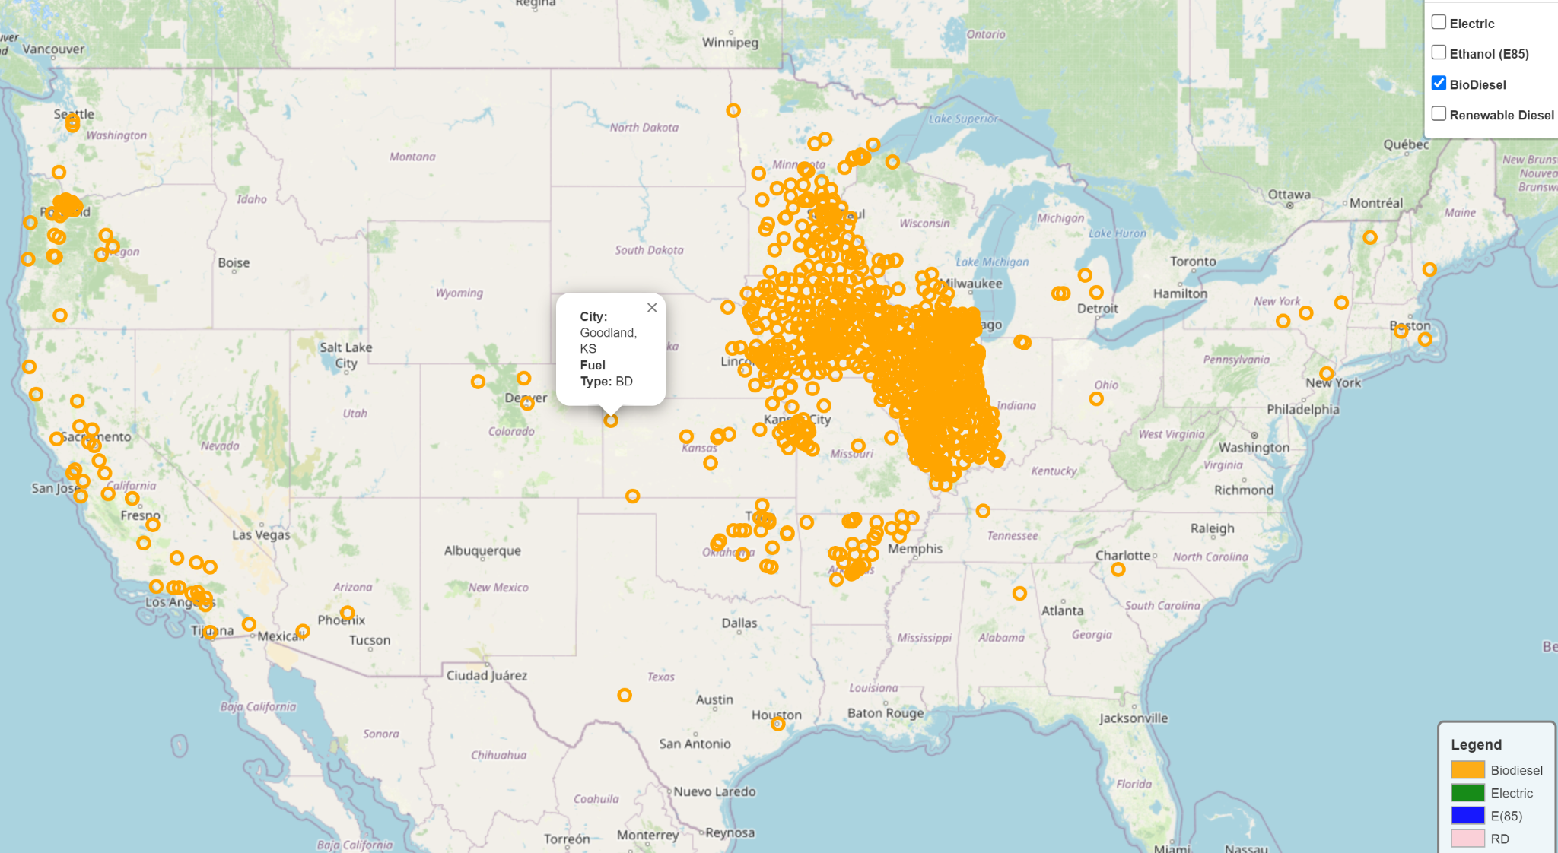
RENEWABLE DIESEL
BIODIESEL

Slide 10
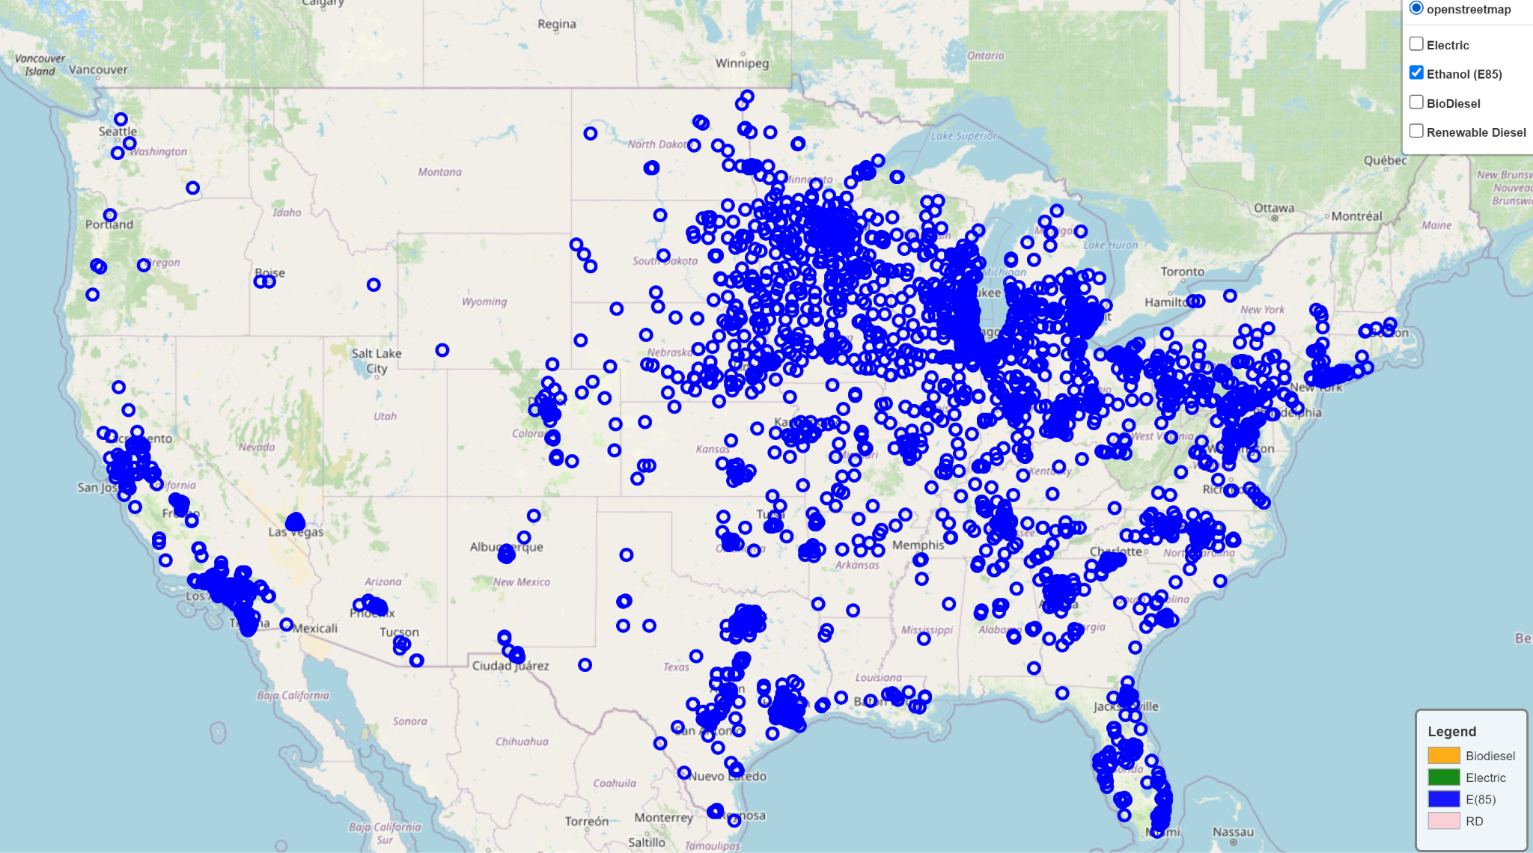
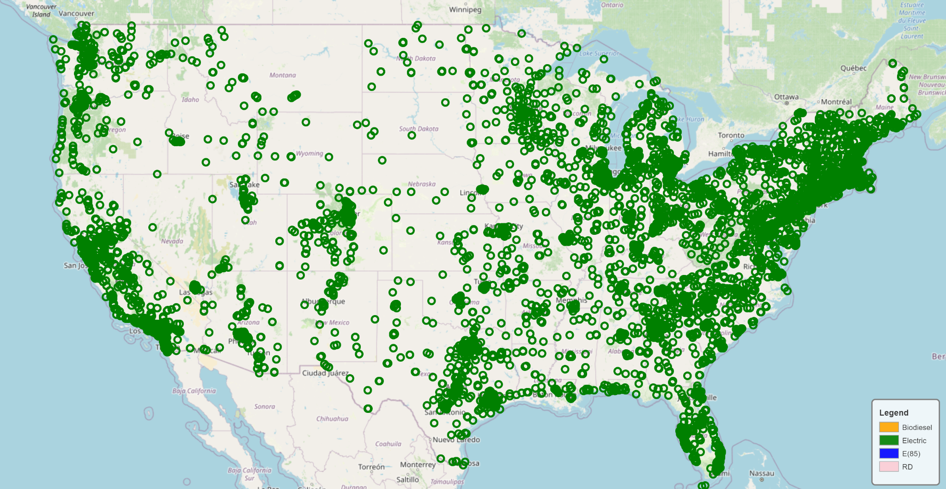
ETHANOL (E85)
Total Biofuel production capacity in US (2023) - 23 billion gallons per year
ELECTRIC

Slide 11
WHICH STATES ARE THE MOST SUPPORTIVE OF ELECTRIC ENERGY VEHICLES, AND WHAT CHARGER TYPES DO THEY USE? (LEVEL 1, LEVEL 2, AND DC CHARGERS)
PRESENTED BY: JOE

Slide 12
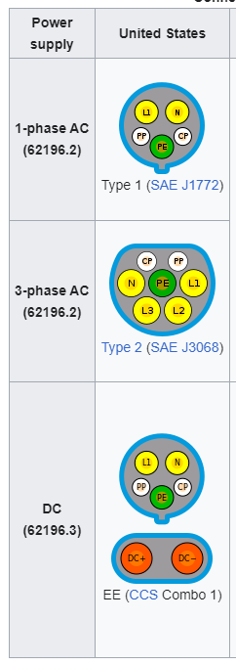
DIFFERENT ELECTRIC VEHICLE
CHARGER TYPES:
LEVEL 1 charging consists of a nozzle cord plugged into a standard 120V electric outlet.
LEVEL 2 charging stations use 240V electric outlets, which means they can charge an EV much faster than Level 1 chargers due to higher energy output.
LEVEL 3 chargers are often called DC (direct current) chargers or “superchargers” due to their ability to fully charge an EV in under an hour.

Slide 13
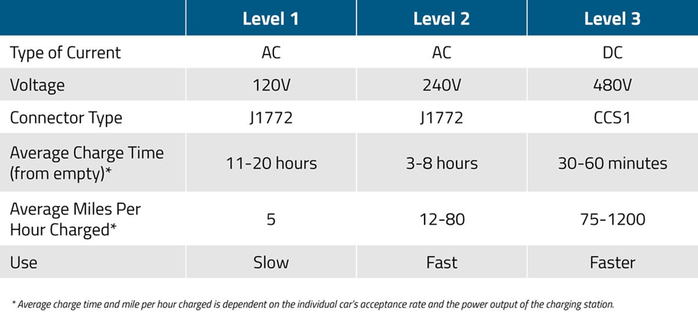
LEVEL 1 VS. LEVEL 2 VS. LEVEL 3 CHARGING STATIONS: WHAT’S THE DIFFERENCE?

Slide 14
EV CHARGING STATIONS AND PORTS IN THE US:
There are 768 LEVEL 1 Ports across 182 Stations
There are 123,850 LEVEL 2 Ports across 53,234 Stations
There are 38,683 LEVEL 3 Ports across 9,127 Stations
There are 163,324 EVSE (Electric Vehicle Supply Equipment) Ports across 61,180 Station Locations in the US
Source: https://afdc.energy.gov/stations#/find/nearest
*These numbers may differ from the data visualizations in this presentation due to our modified dataset

Slide 15
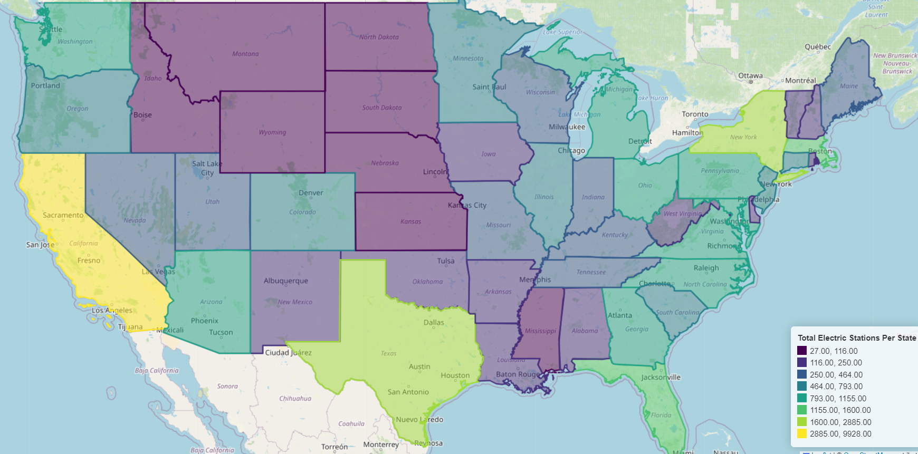
TOTAL NUMBER OF EV CHARGING STATIONS BY STATE:

Slide 16
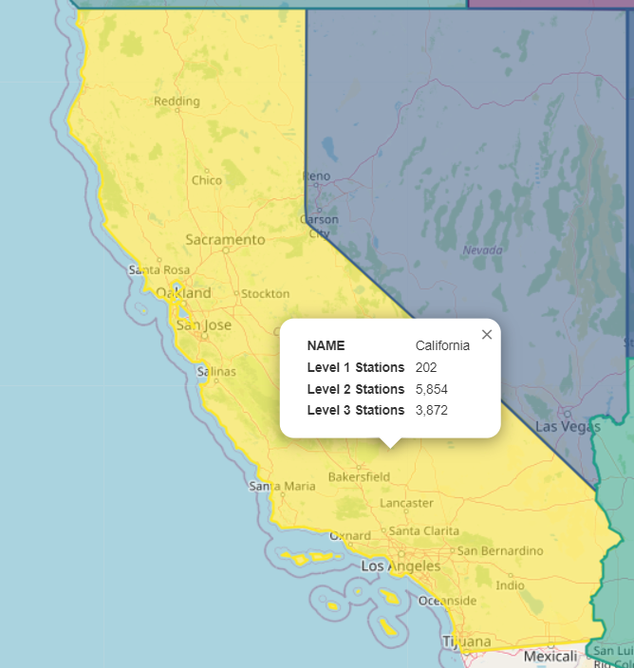
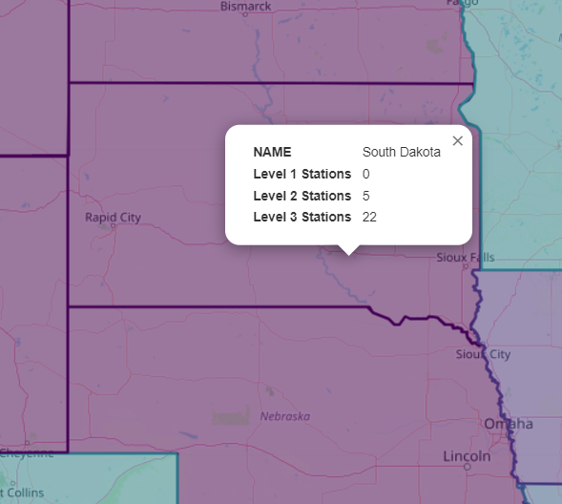
MOST AND LEAST SUPPORTIVE STATES OF ELECTRIC VEHICLES?

Slide 17
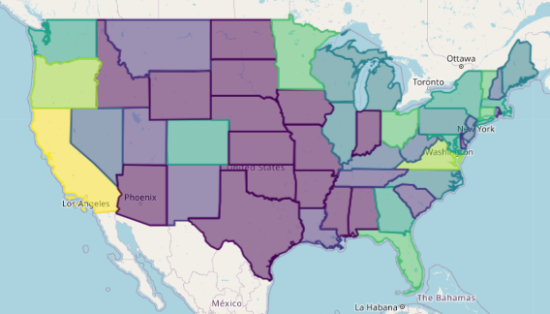
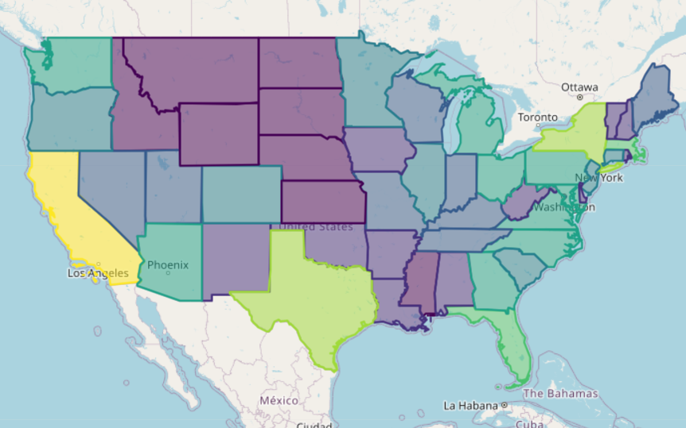
EARLY ADOPTERS VS NOW:
LEVEL 1 CHARGERS ONLY
ALL CHARGER TYPES

Slide 18
WHICH STATES HAVE THE MOST EFFICIENT ELECTRIC VEHICLE CHARGING INFRASTRUCTURE? WHICH STATES ARE NOT IDEAL TO TRAVEL THROUGH WITH AN ELECTRIC VEHICLE IN THE WINTER MONTHS?
PRESENTED BY: RAGHEN

Slide 19
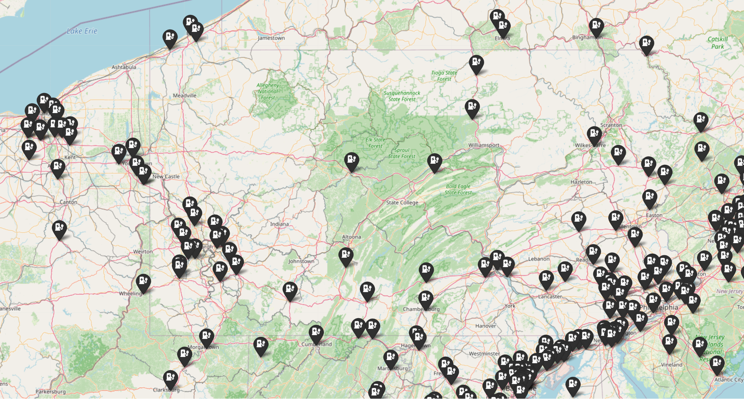
WHICH STATES HAVE THE MOST EFFICIENT ELECTRIC VEHICLE CHARGING INFRASTRUCTURE?
Top 10 States | # of DC Fast Stations | # of Ports
California | 452 | 3872
Florida | 157 | 1070
Texas | 144 | 1366
Virginia | 75 | 399
North Carolina | 72 | 502
Maryland | 69 | 347
New York | 67 | 437
Minnesota | 64 | 243
Michigan | 63 | 234
Pennsylvania | 61 | 446

Slide 20
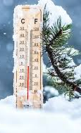
COLD WEATHER VS THE LITHIUM BATTERY
Estimates vary, but according to a study from AAA:
EVs can lose about 40% of their range when the temperature drops from 75 degrees to 20 degrees Fahrenheit.
Lower temps impact a battery’s ability to store and release energy. Charging is typically slower and less efficient as the car uses some energy to keep the battery warm.
Notes:
The range dip is attributed to a couple of things, such as natural battery capacity loss in colder temperatures as well as the increased energy needed for heating the cabin. Using other climate features, such as the heated seats and heated steering wheel, also requires energy and cuts into a car’s range.
For example, an EV with a rated range of 250 miles would have only 150 miles of range when it’s 20 degrees outside.
This is for new cars.. Does not consider battery degradation

Slide 21
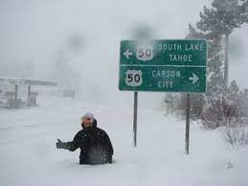
Notes:
It’s important to understand your EV’s range limitations and the need to charge more often in cold weather so you’re not stranded by a dead battery.

Slide 22
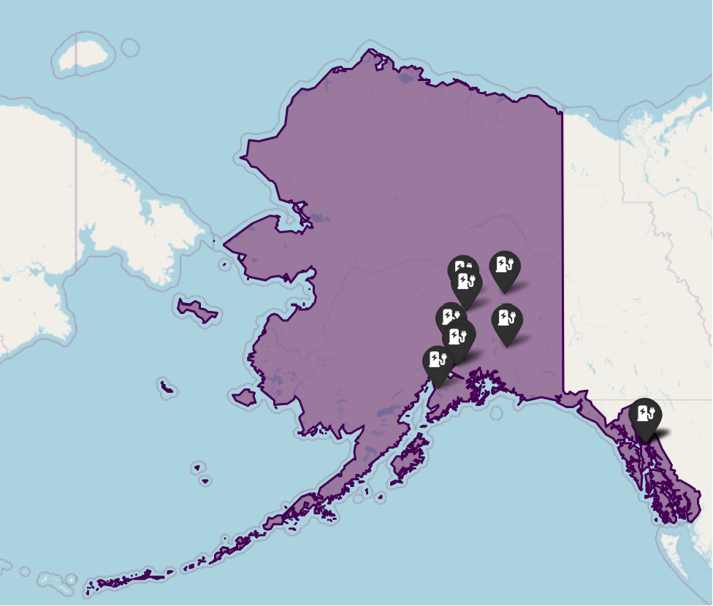
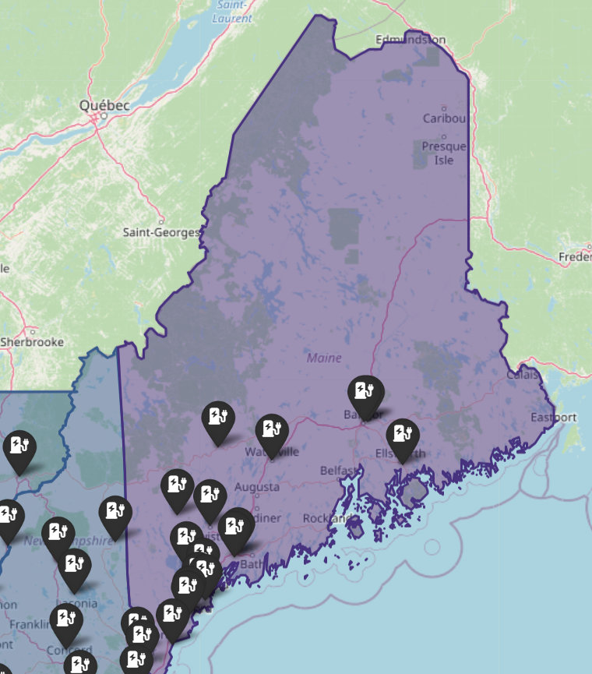
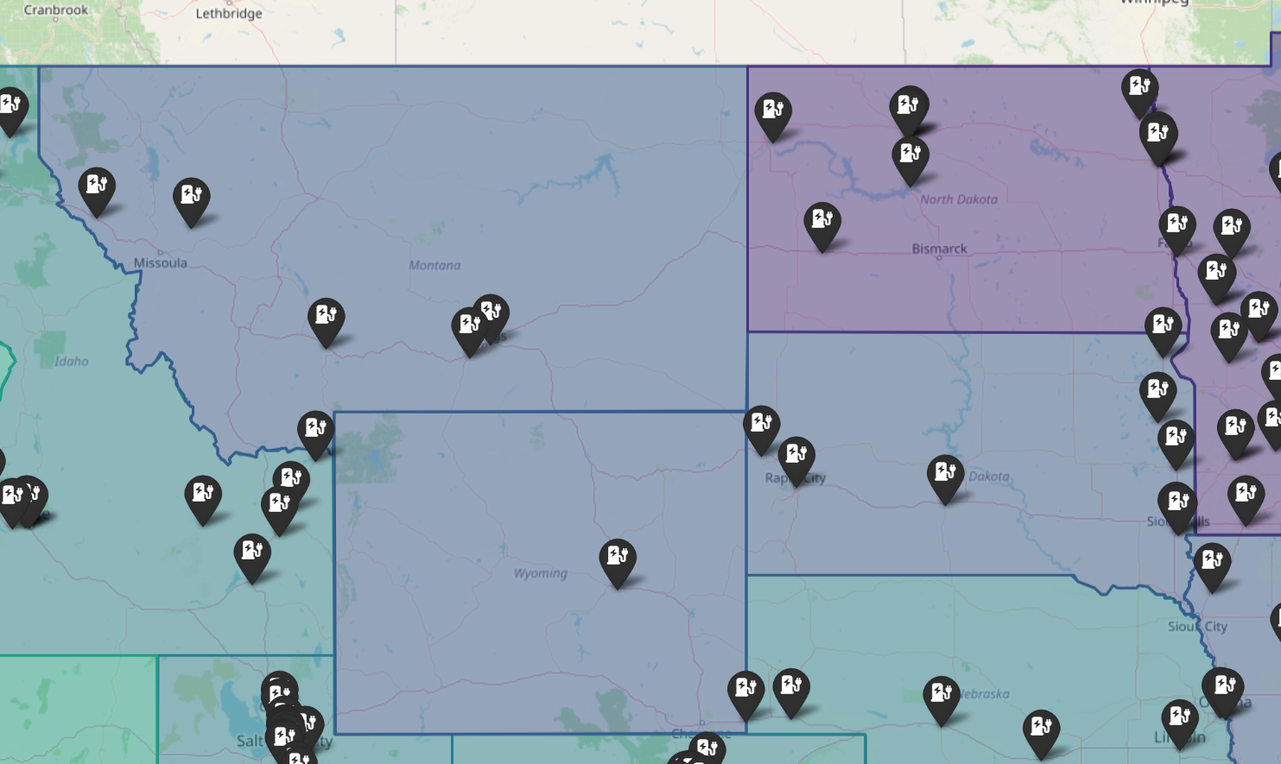
WHICH STATES ARE NOT IDEAL TO TRAVEL THROUGH WITH AN ELECTRIC VEHICLE IN THE WINTER MONTHS?
Upper Maine
Upper Midwest (Montana, Wyoming, South & North Dakota)
Alaska
Let's take a closer look on the interactive map!
Notes:
The temperatures are state-wide averages calculated from temperatures recorded during the months of December, January and February.
The temperatures are based on data collected by weather stations throughout each state during the years 1971 to 2000 and made available by the NOAA National Climatic Data Center of the United States.

Slide 23
THANK YOU!

Slide 24
DATA ETHICS CONSIDERATIONS

Slide 25
Datasets used in the project have been sourced from public APIs. To best of our knowledge no biased datasets have been used for the analysis.
Information referenced (data, code - open source, statistical information) for the project has been listed in Resources section.
No personal information has been used (without consent) for any analysis.

Slide 26
RESOURCES

Slide 27
NREL is a national laboratory of the U.S. Department of Energy, Office of Energy Efficiency and Renewable Energy, operated by the Alliance for Sustainable Energy LLC.
API: https://developer.nrel.gov/docs/transportation/alt-fuel-stations-v1/
https://geopandas.org/en/stable/docs/user_guide/interactive_mapping.html
https://medium.com/@insightsbees/how-to-use-python-folium-to-create-a-choropleth-map-c8cee104455f
https://www.cars.com/articles/how-well-do-electric-cars-work-in-cold-weather-459914/
https://www.caranddriver.com/news/a46340514/ev-sales-are-just-getting-started/
https://www.cbsnews.com/news/electric-cars-ap-norc-poll-should-i-buy-an-ev/
https://nbviewer.org/gist/talbertc-usgs/18f8901fc98f109f2b71156cf3ac81cd
https://www.currentresults.com/Weather/US/average-state-temperatures-in-winter.php
xxx

Slide 28
PROJECT TASK BREAKDOWN

Slide 29
Task | Contributors
Project Ideas | All
Finding Data Sources | All
Data Cleaning | All
Data Analysis: Which states are the most supportive of alternative energy vehicles? (Biodiesel, Ele, Ethanol (E85), Renewable Diesel) | Vinita
Data Analysis: Which states are the most supportive of electric energy vehicles, and what charger types do they use? (Level 1, Level 2, and DC Chargers) | Joe
Data Analysis: Which states have the most efficient electric vehicle charging infrastructure? Which states are not ideal to travel through with an electric vehicle in the winter months? | Raghen
Deck Creation & Prep | All

